Slide 1
Exception-Handling basics
When you write a program, you expect it to work correctly. But sometimes, mistakes happen—like dividing by zero, entering letters instead of numbers, or accessing something that doesn’t exist. These mistakes are called exceptions. If we don’t handle them, the program will suddenly stop, which is not good for users.
Exception handling is a way to manage these errors so the program doesn’t crash. Instead of stopping, the program can show a proper message and continue running. In Java, this is done using try and catch. The try block contains the code that may cause an error, and the catch block handles that error.
For a student, you can think of exception handling like writing an exam: if you don’t know one question (error), you don’t leave the whole paper—you skip it and continue solving the rest. Similarly, exception handling helps the program continue even if an error occurs.

Slide 2
Exception-Handling Fundamentals
An exception is an abnormal condition that arises in a code sequence at run time. In other words, an exception is a runtime error.
When an exceptional condition arises, an object representing that exception is created and thrown in the method that caused the error. That method may choose to handle the exception itself, or pass it on. Either way, at some point, the exception is caught and processed.
Exceptions can be generated by the Java run-time system, or they can be manually generated by your code.
System-generated exceptions are automatically thrown by the Java run-time system.
To manually throw an exception, use the keyword throw.
In Java, an exception is an event that disrupts the normal flow of the program. It is an object which is thrown at runtime.

Slide 3
Exception-Handling Fundamentals
Java exception handling is managed via five keywords: try, catch, throw, throws, and finally.
Program statements that you want to monitor for exceptions are contained within a try block. If an exception occurs within the try block, it is thrown.
Your code can catch this exception (using catch) and handle it in some rational manner.
Any exception that is thrown out of a method must be specified as such by a throws clause.
Any code that absolutely must be executed after a try block completes is put in a finally block.
Exception Handling is a mechanism to handle runtime errors such as ClassNotFoundException, IOException, SQLException, RemoteException, etc.

Slide 4
Throwable class
All exception types are subclasses of the built-in class Throwable.
Throwable is at the top of the exception class hierarchy.
The Throwable class in Java is the root class of the exception handling hierarchy and is a part of the java.lang package. It represents all types of errors and exceptions that can occur during the execution of a program.
Every exception and error in Java is derived from the Throwable class, making it the base class for handling abnormal conditions. It has two main subclasses:
Exception, which represents conditions that a program can catch and handle,
Error, which represents serious problems usually beyond the control of the program.

Slide 5
Exception vs Error
When something goes wrong in a program, it can be either an Exception or an Error, but they are not the same. An Exception is a small, expected problem that can happen while your program is running, and you can handle it in your code. For example, if a user enters a wrong value or you try to divide by zero, the program can catch this problem and show a message instead of crashing. So, exceptions are manageable.
An Error is a serious problem that happens due to the system or Java itself, and you usually cannot handle it in your program. For example, if your program uses too much memory or runs into a serious system failure, it causes an error. In such cases, the program may stop completely.
👉 Simple way to remember:
Exception = problem you can handle
Error = problem you cannot control
👉 Real-life example:
If you forget your pen in an exam → you can borrow one (Exception ✔️)
If you suddenly fall sick during the exam → you cannot continue easily (Error ❌)
So, exceptions help you make your program safe and user-friendly, while errors show that something has gone seriously wrong.

Slide 6
Exception vs Error
The java.lang.Throwable class is the root class of Java Exception hierarchy which is inherited by two subclasses:
1. Exception - This class is used for exceptional conditions that user programs should catch. This is also the class that you will subclass to create your own custom exception types. These are handled using try-catch
2. Error - The other branch is topped by Error, which defines exceptions that are not expected to be caught under normal circumstances by your program. Exceptions of type Error are used by the Java run-time system to indicate errors having to do with the run-time environment, itself. Caused by JVM issues and Cannot usually be handled, non-recoverable.

Slide 7
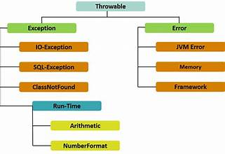
Exception vs Error

Slide 8
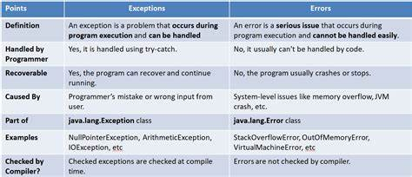
Exception vs Error

Slide 9
Exception Types
1. Checked Exceptions (Compile-Time Exceptions)
Checked exceptions are those exceptions that are checked by the compiler at compile time. The programmer is forced to handle these exceptions either using a try-catch block or by declaring them using throws. These exceptions usually occur due to external conditions like file handling or database operations.
Key Points:
Occur at compile time
Must be handled by the programmer
Improve program reliability
Caused by external resources
Examples:
IOException
FileNotFoundException
SQLException

Slide 10
Exception Types
2. Unchecked Exceptions (Runtime Exceptions)
Unchecked exceptions occur during program execution (runtime) and are not checked by the compiler. These are mainly caused by logical or programming errors such as dividing by zero or accessing invalid memory.
Key Points:
Occur at runtime
Not compulsory to handle
Caused by programming mistakes
Can be avoided by proper coding
Examples:
ArithmeticException
NullPointerException
ArrayIndexOutOfBoundsException

Slide 11
Exception Types
3. Errors
Errors are serious problems that occur in the Java Virtual Machine (JVM) and are beyond the control of the programmer. These are not meant to be handled using normal exception handling.
Key Points:
Caused by system failures
Cannot be handled easily
Rare but critical
Examples:
OutOfMemoryError
StackOverflowError

Slide 12
Exception-Handling Fundamentals
package exceptionhandling;
public class E1 {
public static void main(String[] args) {
int d = 0;
int a = 10 / d;
System.out.println(a);
System.out.println(“Program Ends”);}}
OUTPUT :-
Exception in thread "main" java.lang.ArithmeticException: / by zero
at exceptionhandling.E1.main(E1.java:5)

Slide 13
Exception-Handling Fundamentals
package exceptionhandling;
public class E2 {
static void show() {
int d = 0;
int a = 10 / d;
System.out.println(a);}
public static void main(String[] args) {
E2.show();}}
OUTPUT :-
Exception in thread "main" java.lang.ArithmeticException: / by zero
at exceptionhandling.E2.show(E2.java:5)
at exceptionhandling.E2.main(E2.java:9)

Slide 14
Exception-Handling Fundamentals
Step-by-Step Execution(Without exception handling)
main() method calls show()
Inside show():
Variable d is assigned value 0
Expression 10 / d is executed
Division by zero occurs → ArithmeticException
JVM:
Creates an exception object
Stops execution of current method (show())
Searches for exception handler (try and catch block)
No try-catch block is present
JVM cannot find a handler in show()
Exception propagates to main()
Still no handler → JVM terminates program
This process is called Exception Propagation
Exception handling overcomes runtime errors by placing risky code inside a try block and handling the error in a catch block. When an exception occurs, control shifts from the try block to the catch block, preventing program termination and allowing smooth continuation of execution.

Slide 15
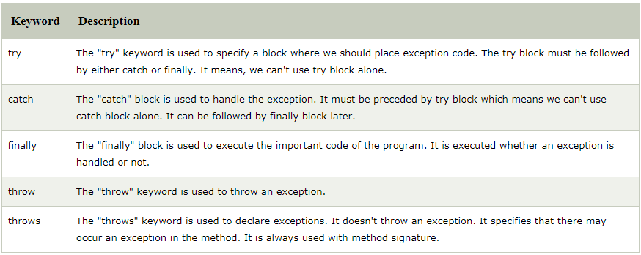
Exception-Handling Keywords

Slide 16
try - catch syntax
try {
// block of code to monitor for errors
}
catch (ExceptionType1 exOb) {
// exception handler for ExceptionType1
}
catch (ExceptionType2 exOb) {
// exception handler for ExceptionType2
}
// ...
finally {
// block of code to be executed after try block ends
}

Slide 17
Using try and catch
Handle an exception
First, it allows you to fix the error.
Second, it prevents the program from automatically terminating.
To guard against and handle a run time error, simply enclose the code that you want to monitor inside a try block .
Immediately following the try block, include a catch clause that specifies the exception type that you wish to catch.

Slide 18
Using try and catch
Although default exception handler provided by java runtime system is useful for debugging, you will usually want to handle an exception yourself. Its benefits are- It allows to fix error and prevents the program from automatically terminating.
The catch block should be immediately following try block.
Scope of catch clause is restricted to those statements specified by the immediately preceding try statement.
Catch clause will only catch exception thrown by just preceding try clause.
Catch statements must be surrounded by {} curly braces, they must be within block.
Try statements must be surrounded by {} curly braces, they must be within block.
When exception is thrown by any statement of try block, the control comes of try block and goes to catch block, the catch statements gets executed and control transfers to statements next to catch block(if any).

Slide 19
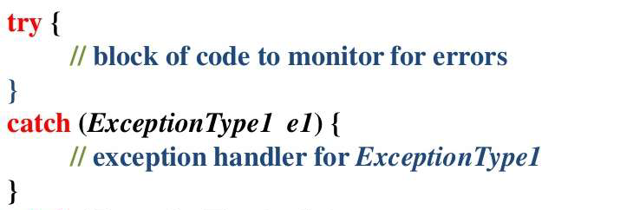
Using try and catch
ExceptionType - (Type of Exception)
Exception is the class type of the object that the catch block will handle.
It tells Java which kind of error this catch block is designed to handle.
e – (Reference Variable)
e is the object reference to the caught exception.
When an exception occurs, Java creates an object of that exception type and passes it to the catch block.
You can use e to get information about the exception.

Slide 20
Using try and catch
package exceptionhandling;
public class E3 {
public static void main(String[] args) {
try {
int d = 0;
int a = 10 / d;
System.out.println(a);}
catch (ArithmeticException e) {
System.out.println("Divide by zero");}
System.out.println("After catch STATEMENT");}}
Output:-
Divide by zero
After catch STATEMENT

Slide 21
Displaying a Description of an Exception
When an exception occurs, Java creates an object of the subclass of Throwable.
Throwable overrides the toString( ) method (defined by Object) so that it returns a string containing a description of the exception.
e is the object reference, so it returns a string containing a description of exception.
You can display this description in a println( ) statement by simply passing exception as argument.
If we just System.out.println(e), it actually calls e.toString internally
e.getMessage( ) – Return a short description of exception
e or e.toString( ) – Returns exception type and description
e.printStackTrace( ) – Print full stack trace as type, message and where it occurred.

Slide 22
Displaying a Description of an Exception
package exceptionhandling;
public class displayedescription {
public static void main(String[] args) {
try {
int d = 0;
int a = 10 / d;
System.out.println(a);}
catch (ArithmeticException e) {
System.out.println("Exception:"+e);
System.out.println("Message : "+e.getMessage());
e.printStackTrace();}}}
StackTrace – When a program throws an exception and does not handle it, the runtime prints a stack trace (Exception Type, Error Message, Call Stack which contains list of functions that were called and also their order).
OUTPUT :-
Exception:java.lang.ArithmeticException: / by zero
Message : / by zero
java.lang.ArithmeticException: / by zero
at exceptionhandling.displayedescription.main(displayedescription.java:6)

Slide 23
Exception Examples
Some Exception Examples are –
ArithmeticException - Occurs when a mathematical error happens (like Divide by zero).
Null PointerException - Occurs when you are using a null object.
ArrayIndexOutOfBoundsException – Accessing invalid index in an array.
NumberFormatException - Converting invalid string to number.
StringIndexOutOfBounds – Accessing invalid index in string.
ClassNotFoundException – When a class is not found during runtime.
FileNotFound - File does not Exist.

Slide 24
Multiple catch Clauses
In some cases, more than one exception could be raised by a single piece of code. To handle this type of situation, you can specify two or more catch clauses, each catching a different type of exception.
Multiple Catch Clauses are used to handle different exceptions separately in one try block.
Each catch block handles a specific type of exception.
Only one catch block executes when an exception occurs.
When an exception is thrown, each catch statement is inspected in order, and the first one whose type matches that of the exception is executed.
After one catch statement executes, the others are bypassed, and execution continues after the try/catch block .

Slide 25
Multiple catch Clauses
Basic Syntax :-
try {
// Code that might throw an exception
}
catch (ExceptionType1 e1){
// Handle Exception 1
}
catch (ExceptionType2 e2){
// Handle Exception 2
}
catch (ExceptionType e){
// Handle any other Exception
}

Slide 26
Multiple catch Clauses
package exceptionhandling;
public class multiplecatchclause {
public static void main(String[] args) {
try {
int a = 0;
System.out.println("a = " + a);
int b = 42 / a;
int c[] = { 1 };
c[42] = 99;
}
catch(ArithmeticException e) {
System.out.println("Divide by 0: " + e);
}
catch(ArrayIndexOutOfBoundsException e) {
System.out.println("Array index oob: " + e);
}
System.out.println("After try/catch blocks statement.");}}
OUTPUT -
a = 0
Divide by 0: java.lang.ArithmeticException: / by zero
After try/catch blocks statement.

Slide 27
Nested Try Statements
The try statement can be nested. That is, a try statement can be inside the block of another try.
Each time a try statement is entered, the context of that exception is pushed on the stack.
If an inner try statement does not have a catch handler for a particular exception, the stack is unwound and the next try statement’s catch handlers are inspected for a match.
This continues until one of the catch statements succeeds, or until all of the nested try statements are exhausted.
If no catch statement matches, then the Java run-time system.
Syntax :-
try {
try { // nested try block
}
} catch(ArrayIndexOutOfBoundsException e) {
}}
catch(ArithmeticException e) {
}}
}

Slide 28
Nested Try Statements
package exceptionhandling;
public class nestedtry{
public static void main(String args[]) {
try {
int a[]= {1,2,3,4,5};
System.out.println(a[11]);
try {
int x=a[11]/0;
}
catch(ArithmeticException e2){
System.out.println("Division on by zero is not posible");}
}
catch(ArrayIndexOutOfBoundsException e1) {
System.out.println("ArrayIndexOutOfBoundsException");
System.out.println("Element at such index does not exist");
}
System.out.println("Statement after nested try catch in executed");
}}
OUTPUT -
ArrayIndexOutOfBoundsException
Element at such index does not exist
Statement after nested try catch in executed

Slide 29
Throw
Throw is used to define our own exception.
The Throw keyword is used to explicitly throw an exception from a method or any block of code.
The Throw keyword is mainly used to throw custom exceptions.
While Java Runtime can automatically throw exceptions like ArithmeticExceptions for division by zero, Throw allows a developer to do so manually based on custom logic or business rules.
Syntax –
Throw new ExceptionType (“Optional Message”)
ExceptionType – is a class that extendThrowable
new – is used to create new object of class / subclass of throwable.
Throwable Object must be an instance of java.lang.throwable class or one of its subclasses
Only objects that are instances of throwable or its subclasses can be thrown by JVM or explicitly by a throw statement.
Throwable class is the superclass of all errors and exceptions in the Java.
Throw is used to expilicitly throw an exception.
It is used inside a method or block
One one exception can be thrown at a time
After throw, the program stops execution unless handled.

Slide 30
Throw Example (without try-catch)
package exceptionhandling;
public class throw1{
public static void validateAge(int age) {
if (age < 18) {
throw new ArithmeticException(“Access denied – You must be 18+");
} else {
System.out.println(“Access granted – You are eligible");
}}
public static void main(String[] args) {
System.out.println(“Program Started”);
validateAge(16);
System.out.println(“Program Ended”);
}}
OUTPUT –
Program Started
Exception in thread “main”
Java.lang.ArithmeticException : Access denied – You must be 18+");
Age is valid

Slide 31
Throw Example (with try catch)
package exceptionhandling;
public class throw1{
public static void checkNumber(int num) {
if (num < 0) {
throw new IllegalArgumentException(“Number cannot be negative");
} else {
System.out.println(“Valid Number " );
}
}
public static void main(String[] args) {
try{
checkNumber(-5);
}
catch (IllegalArgumentException e) {
System.out.println("Exception Caught : " + e.getMessage());
}
System.out.println(“Program continues . . . . . “); } }
OUTPUT -
Exception Caught: Number cannot be negative
Program Continues . . . . .

Slide 32
Throw Example explanation
Understanding the examples OF THROW :
Throw is used to throw an exception only with defining the name and short description of that exception. It throw and exception which is custommade , which otherwise would have not thrown by Java. We define our own exception nd throw it on our own.
1st exmaple (Without try - catch) – Exception is thrown using throw. Not handled i.e. no try & catch used, So program terminates immediately. In this case JVM , handles it and leads to abnormal termination. So the print statement after validateage(16) does not run.
2nd example (With try – catch) – Exception is thrown using using throw. Then handled using try & catch, So program continues normally. We know programs statements run normally after the last catch clause, when any one catch clause matches. In this case Catch handles it and leads to normal termination that is all statements after last cat h clause are executed. So the print statement after catch clause runs normally.

Slide 33
Throws
Throws is used in method signature to pass exception responsibility to the caller.
Syntax –
Public void readFile ( ) throws ExceptionType {
// code
}
It is used in method signature.
It does not handle the exception
It simply passes the exception to the calling method
Mainly used for checked exceptions
When using throw - The method threw an exception and the same method handled it.
Actually exception is thrown.
Send exception to whenever method was called from.
Create & throw exception
When using throws – Now ValidateAge( ) throws the exception, main ( ) catches the exception. This is the proper use of throws in method declaration.
Only declares that exception might occur.
This method might throw an exception.
I am not handling it. Whoever calls it must handle it.

Slide 34
Throws Example
package exceptionhandling;
public class throw1{
public static void checkNumber(int num) throws IllegalArgumentException{
if (num < 0) {
throw new IllegalArgumentException(“Number cannot be negative");
} else {
System.out.println(“Valid Number " );
}
}
public static void main(String[] args) {
try{
checkNumber(-5);
}
catch (IllegalArgumentException e) {
System.out.println("Exception Caught : " + e.getMessage());
}
System.out.println(“Program continues . . . . . “); } }
OUTPUT -
Exception Caught: Number cannot be negative
Program Continues . . . . .

Slide 35
Throws example explanation
Method Declaration
Method Declaration has Changed – Added throws IllegalArgumentException.
You are declaring that this method may throw an exception.
This is the role of throws.
throw actually throws exception, throws declares that method may throw exception
Throwing Exception
You are actually creating and throwing the exception.
This the role of throw.
Handling in main()
Exception is caught and handled using catch clause in main method, so program does not terminate i.e. statements after last catch clause runs.
Need for throws
Throws tell compiler and programmer that a method may generate an exception.
When a method uses throws, it does not handle the exception itself. Instead . It passes the rwesposibility of handling to the calling method.

Slide 36
Finally
Finally block of code always run whether there is an exception occurred or not.
The finally block is used to execute important code (like cleanup) whether an exception occurs or not.
Syntax –
try {
//code to be monitored
}
Catch(Exception e){
//handling exception
}
Finally {
//always execute
}
It is always written after try and catch blocks, and is always execeuted.
If not exception occurs, try block executes completely, then finally is executed
Helps avoid memory or resource leakage.

Slide 37
Finally example
package exceptionhandling;
public class finallyy {
public static void main(String[] args) {
try {
System.out.println("Inside try block");
int result=10/0;
} catch (Exception e) {
System.out.println("Exception caught: " + e.getMessage());
}
finally {
System.out.println("Finally Block Executed");
}
System.out.println("Program Continues.........");
} }
In this code we have used ((Exception e), instead of (ArithmeticException e) because exception is a parent class, while ArithmeticException is a child class. So simply writing Exception will handle all types of exceptions, including ArithmeticException also
OUTPUT –
Inside try block
Exception caught: / by zero
Finally Block Executed
Program Continues.........

